Slide 1
SPECIAL USE PERMIT CASE NUMBER WSUP19-0025
Cold Springs AT&T Wireless
Cellular Communication Tower
Washoe County Board of Adjustment
December 5, 2019

Slide 2
Request
85-foot-tall cellular communication tower, that is proposed to look like a pine tree (“monopine”)

Slide 3
Overview
Public and Semi-Public Facilities (PSP) Regulatory Zone
Allows for monopole antennas with approval of a special use permit
Allows a height of 75 feet
Allows for an additional 25 percent of the allowable height for a pole with “stealth design” such as the pine tree proposed
Overall allowable height is 93.75 feet
Requesting a pole of 85 feet in height

Slide 4
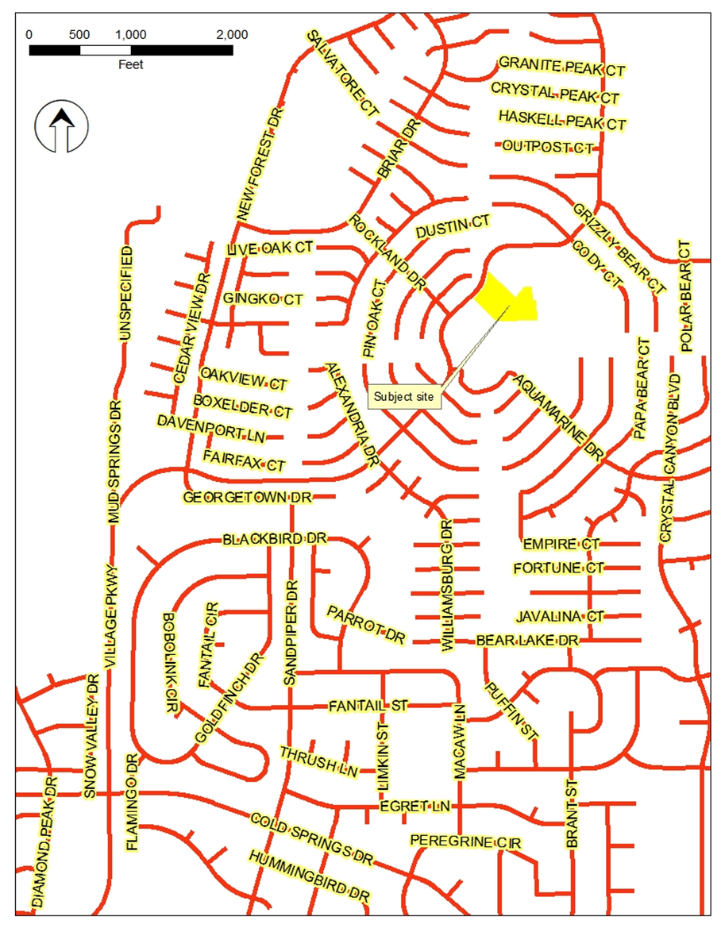
Vicinity Map

Slide 5
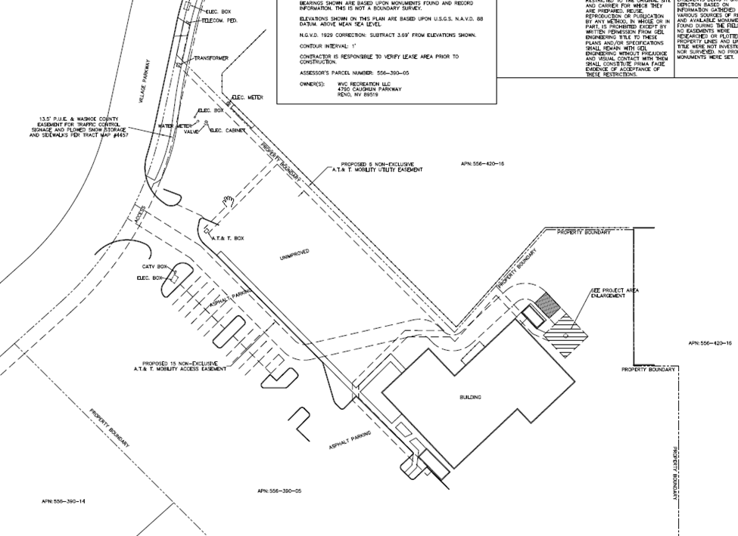
Overview – Location
Proposed to be located adjacent to community center

Slide 6
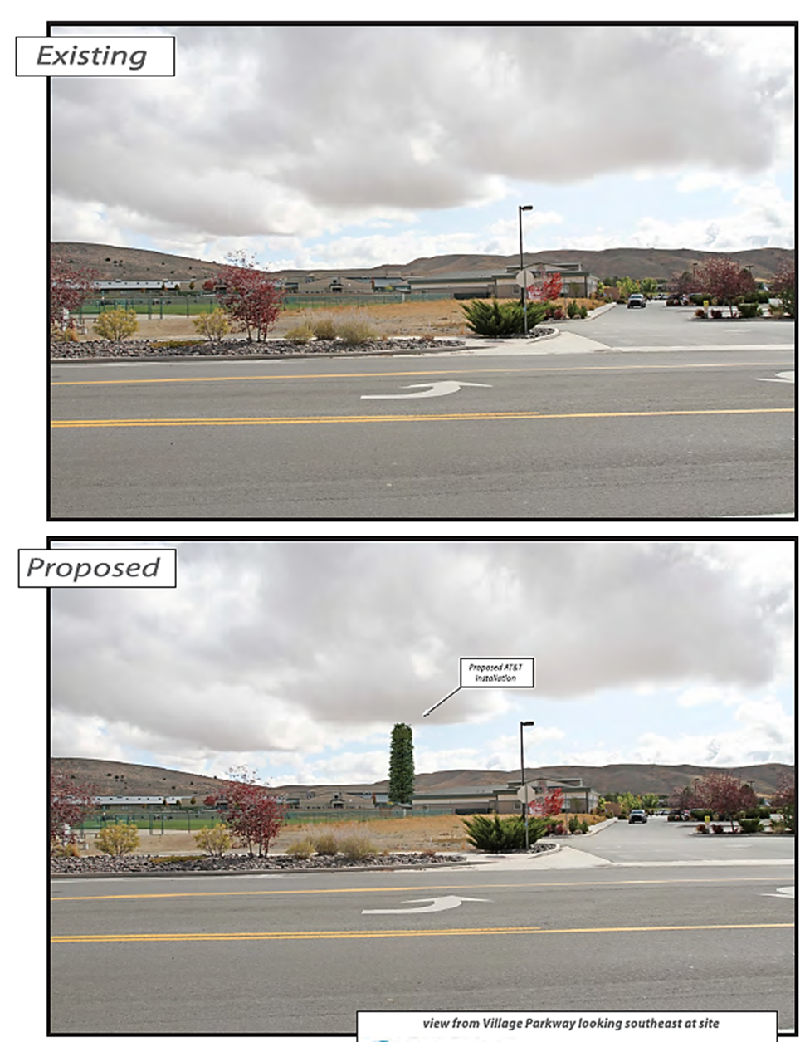
Overview

Slide 7
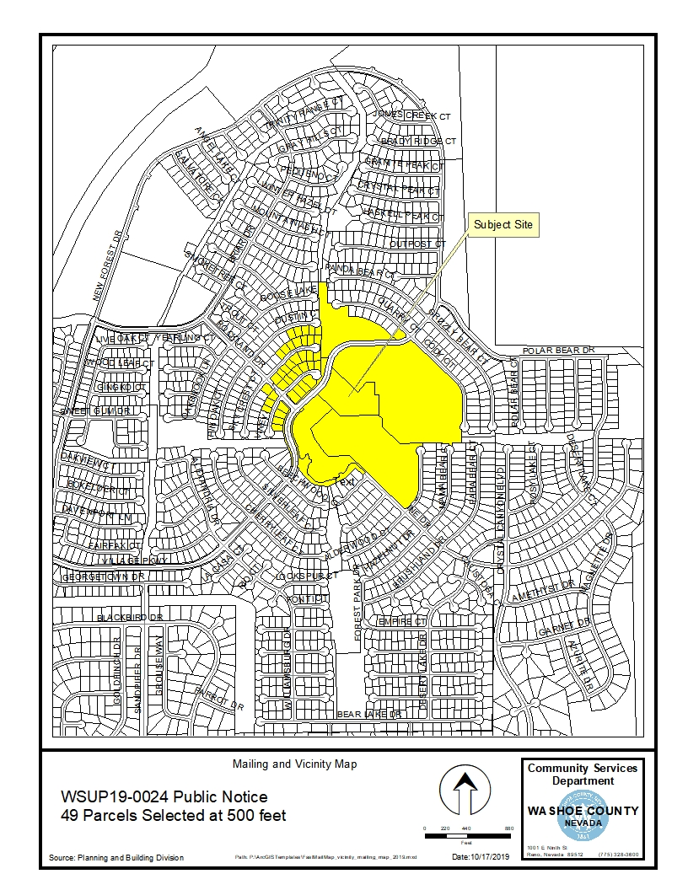
Public Notice & CAB
Notice sent to 49 affected property owners
No CAB meeting during the review for this permit. No individual comments received.

Slide 8
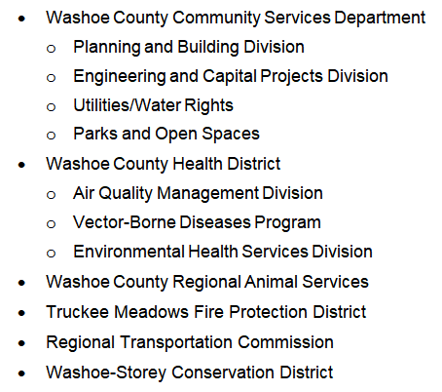
Reviewing Agencies

Slide 9
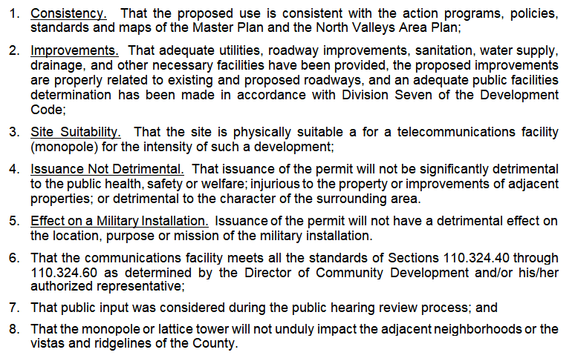
Special Use Permit Findings

Slide 10
Analysis and Recommendation
Recommending approval subject to generally applicable standards as would be applied to any other new commercial use.

Slide 11
Possible Motion
I move that, after giving reasoned consideration to the information contained in the staff report and information received during the public hearing, the Washoe County Board of Adjustment approve with conditions Special Use Permit Case Number WSUP19-0025 for Epic Wireless on behalf of AT&T Wireless, having made all five findings in accordance with Washoe County Code Section 110.810.30, and all three findings in accordance with WCC Section 110.324.75, subject to the conditions of approval contained in Exhibit A to the Staff Report.

